Slide 1
Overset Grid Symposium 2026
University of Maryland
Alfred Gessow Rotorcraft Center
Acoustic Analysis of CRC-10 Takeoff Maneuver
Tague Carlyon (PhD Student)
Dr. Paulo Arias
Dr. James Baeder

Slide 2
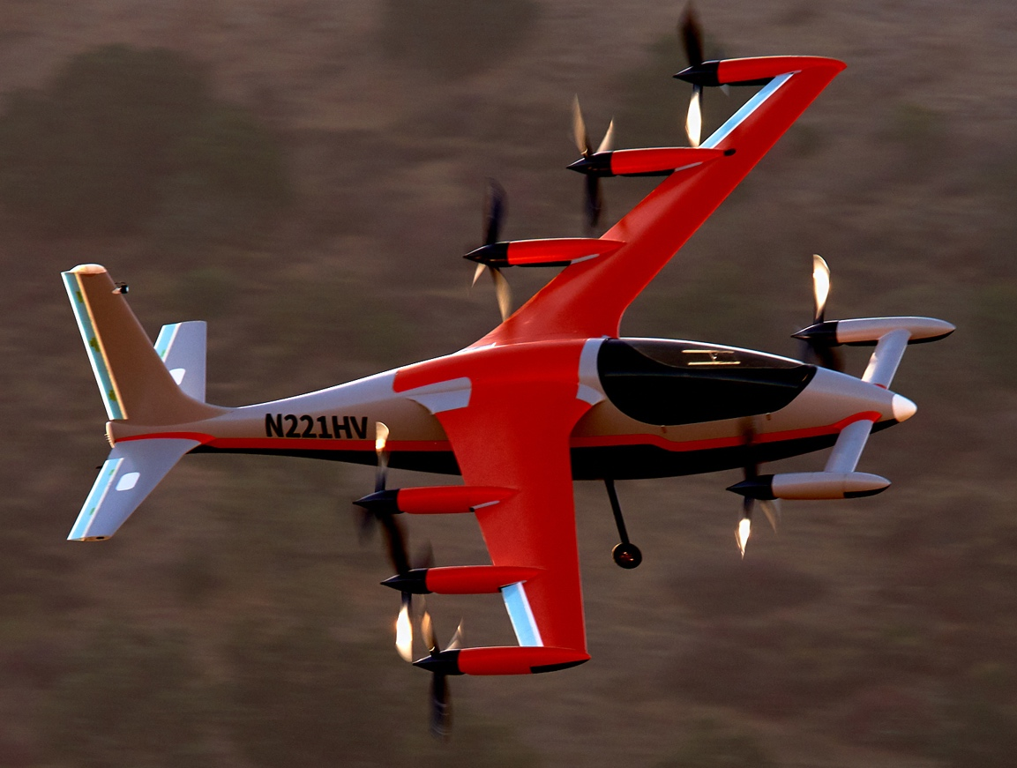
Motivation
University of Maryland
Alfred Gessow Rotorcraft Center
Complexity of Advanced Air Mobility (AAM) Aircraft
  Different modes for hover and cruise, e.g.
  Larger number of interacting components
Advances in CFD/CAA and HPC systems capabilities
Need for an accurate knowledge of the unsteady air loads for understanding noise
  Isolated versus build-up versus installed in cruise and hover
  Interactions during transitional flight (hover-to-cruise and cruise-to-hover)
  Phasing of rotors may be important
Goals require coupling to flight mechanics analysis
  Ramifications of non-periodicity on performance, vibrations and noise
Bell: Autonomous Pod Transport
Kitty-Hawk:
Heaviside
Notes:
Many rotors/propellers with nacelles, pylons, wings and connecting struts

Slide 3
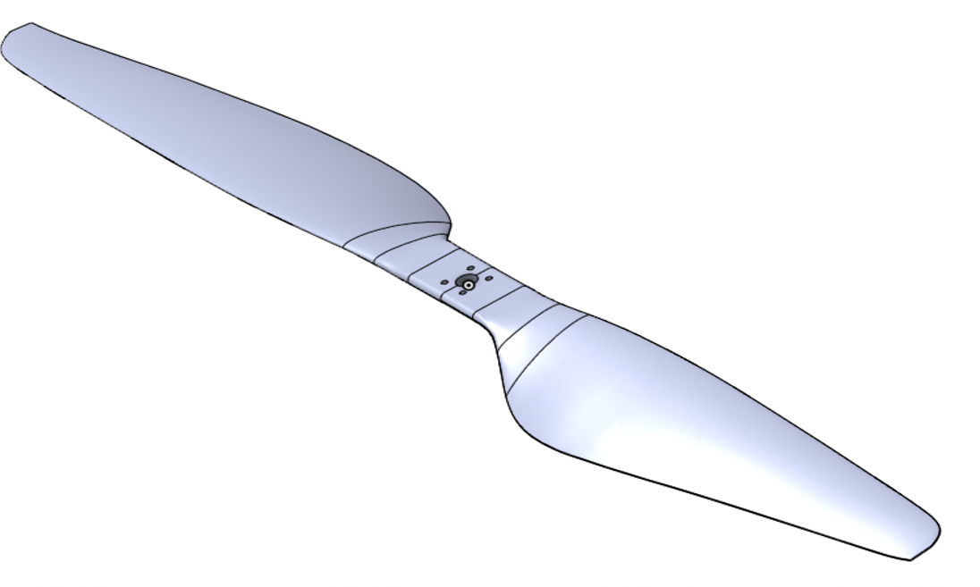
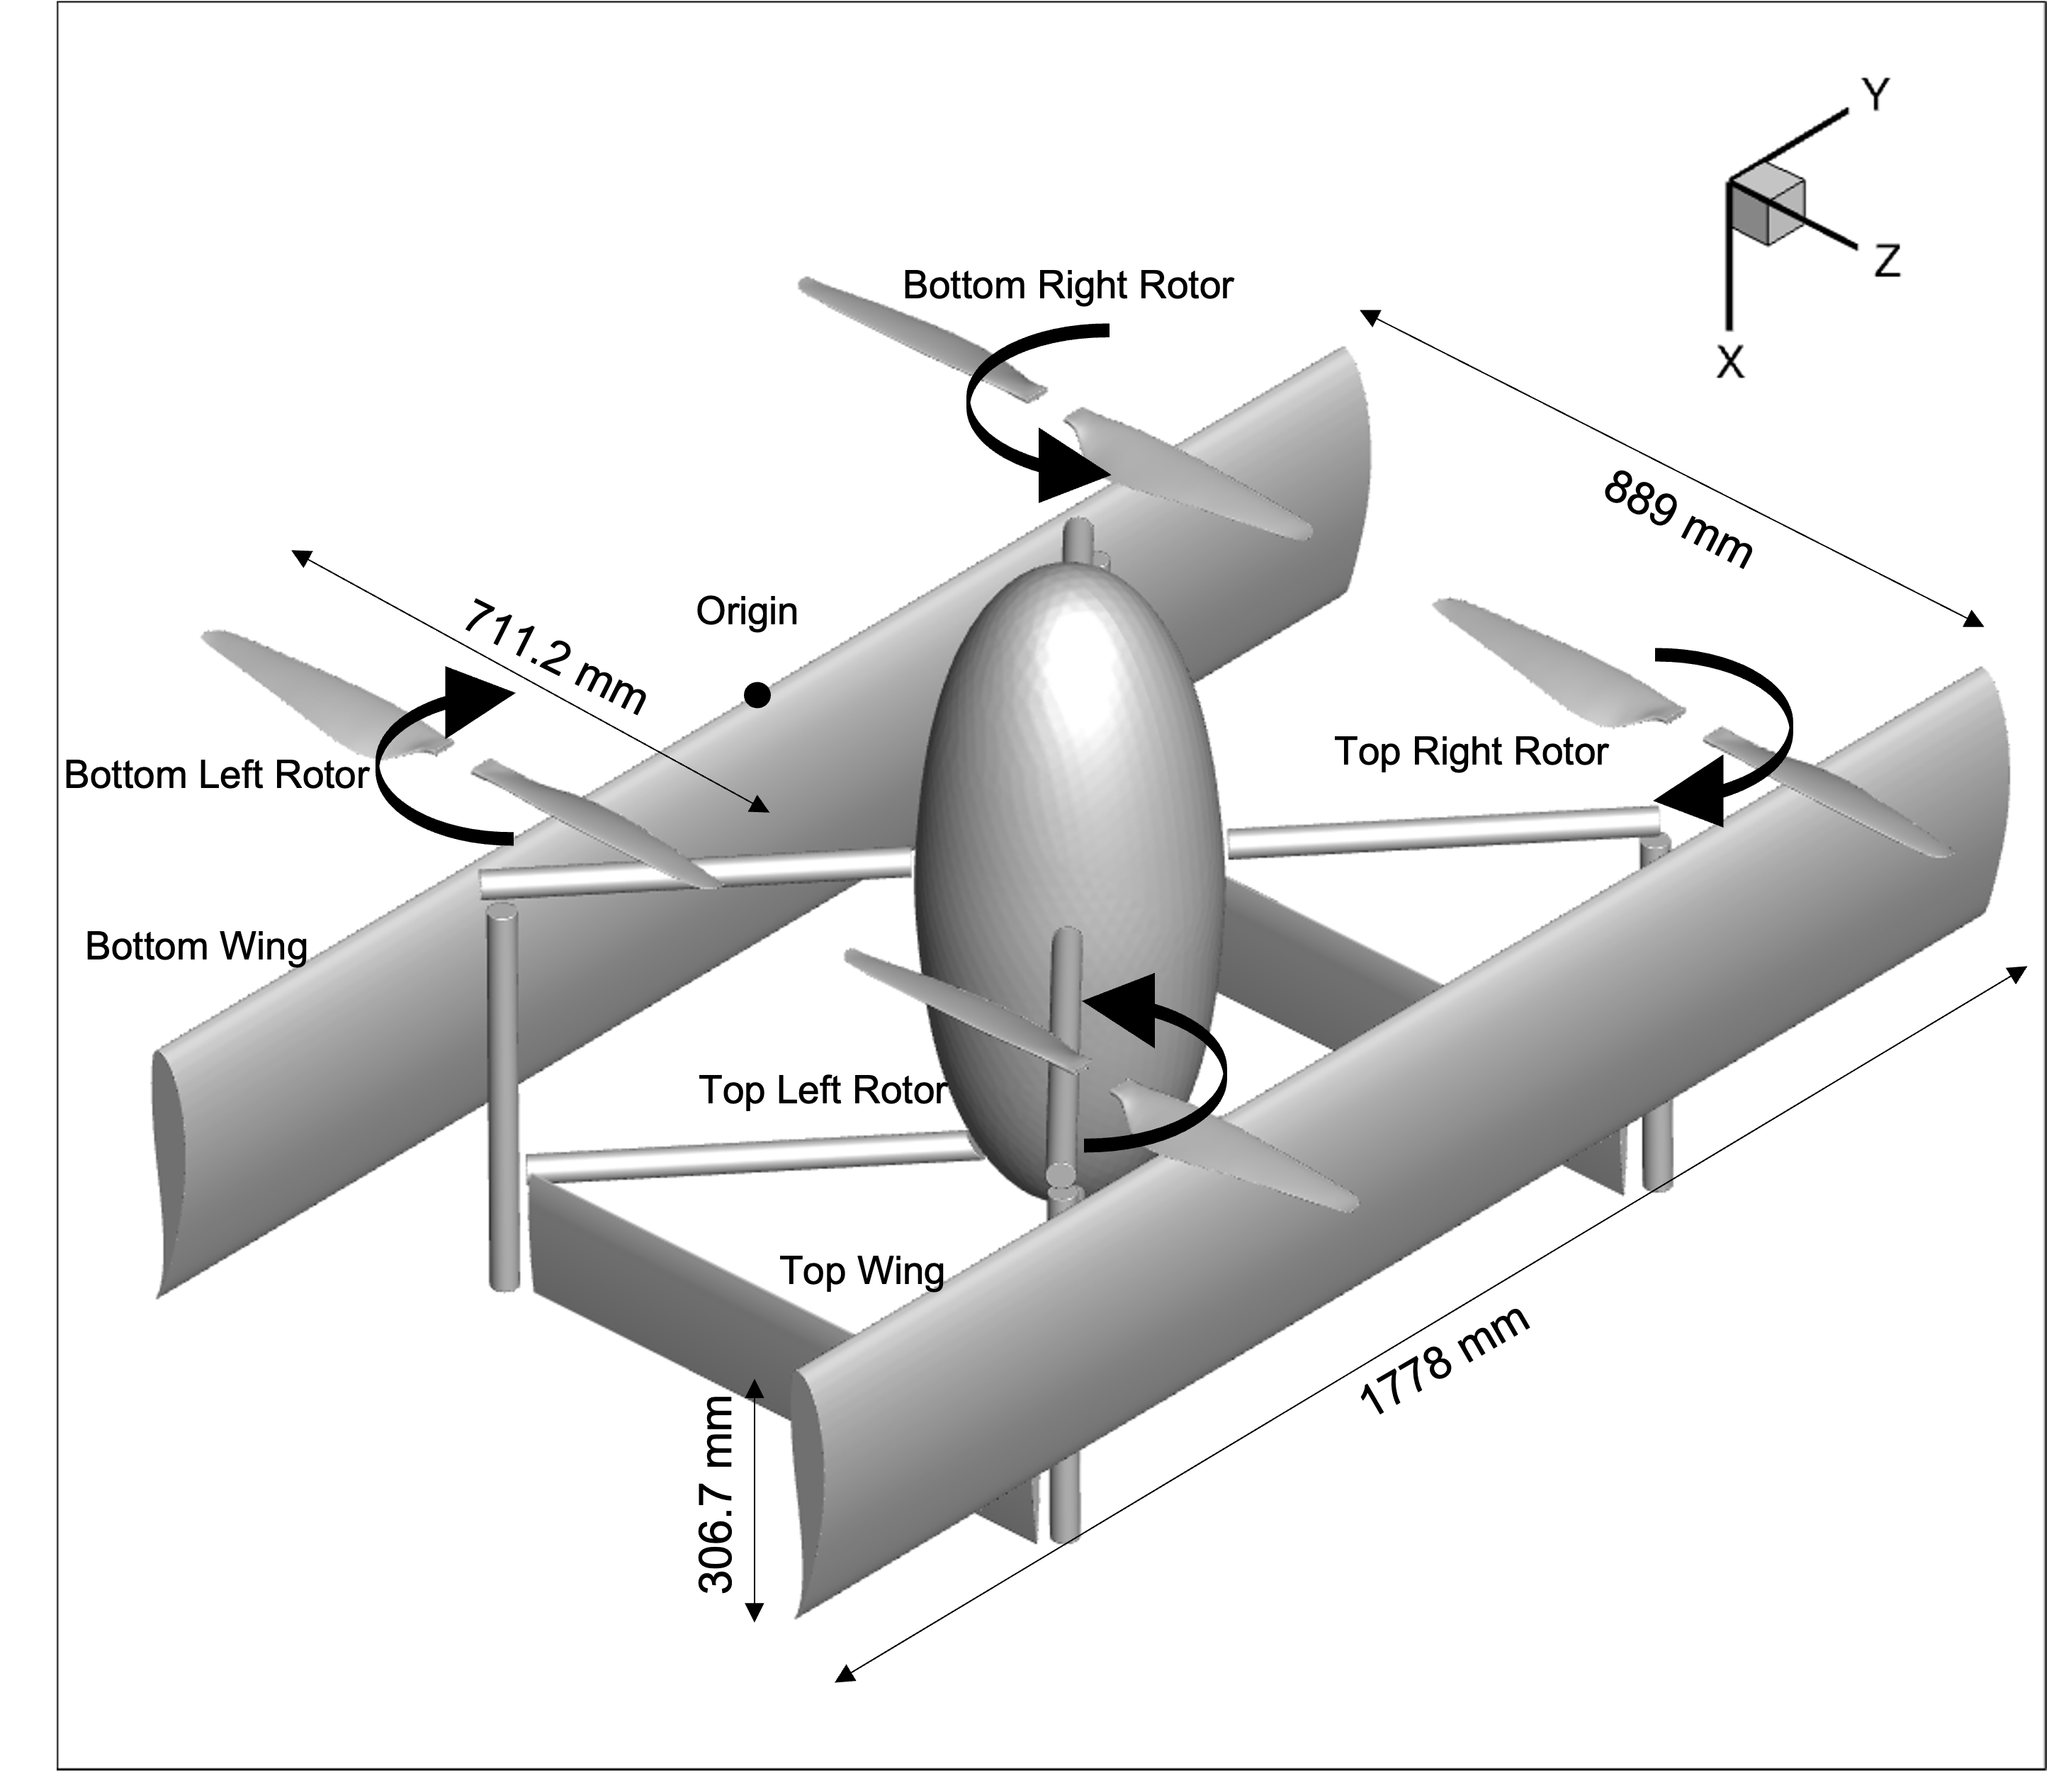
Model Geometry
University of Maryland
Alfred Gessow Rotorcraft Center
Quadrotor Biplane Tailsitter chosen:
    Complex aircraft, large number of interacting components
    Unique and intricate transitions between flight modes
Airframe
    CRC-10 from ARL
    Scaled up by 3.5
    Gross take-off weight – 80 lbs
Rotors
    T-MOTOR G28 x 9.2 rotor blades
    Truncated at 7% radius to apply collective
T-Motor G28x9.2 blades
Final model dimensions
Notes:
Look at wing reynolds number

Slide 4
Transition Simulation Methodology
University of Maryland
Alfred Gessow Rotorcraft Center
Flight Dynamics Model
In-house code GenMR
Create realistic model of CRC biplane
Low fidelity aerodynamics
Generate controls and trajectory data
High-Fidelity Aerodynamics
In-house CFD framework Mercury
Develop maneuver capabilities
Prescribe maneuver from GenMR model
Notes:
GenMR is closed source and author refuses to explain
Paulo tried having DUST run as mid fidelity it didn't work (I don't know why)

Slide 5
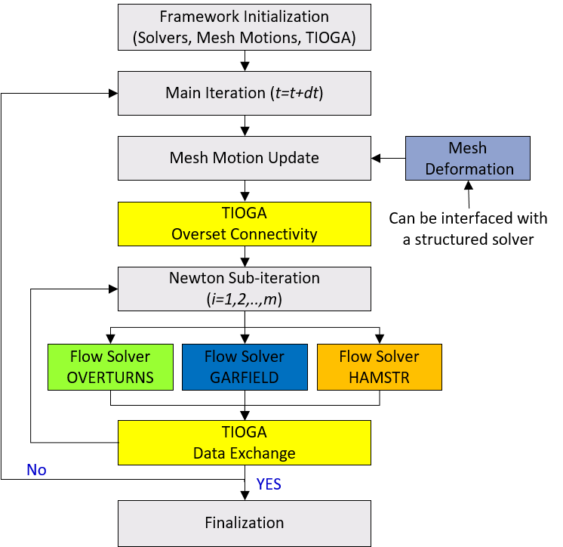
Mercury CFD Framework
University of Maryland
Alfred Gessow Rotorcraft Center
HAMSTR (Hamiltonian/Strand Solver)
  Unstructured solver
  Near-body meshes
GARFIELD (GPU-Accelerated Rotor Flow Field Solver)
  Structured solver
  Off-body meshes
TIOGA (Topology Independent Overset Grid Assembler)
  Data Exchange between solvers and meshes
Acoustics ACM
Notes:
Heterogeneous CPU-GPU multi-solver framework based on RANS

Slide 6
Mercury CFD Framework
University of Maryland
Alfred Gessow Rotorcraft Center
HAMSTR (Hamiltonian/Strand Solver)
  WENO-5 reconstruction
  BDF2 time stepping
  Roe Flux scheme (Harten entropy fix, Rapier's Low-Mach correction)
  Spalart allmaras
  DDLGS solver
GARFIELD (GPU-Accelerated Rotor Flow Field Solver)
  WENO-5 reconstruction
  BDF2 time stepping
  Roe Flux scheme (Harten entropy fix, no Rapier)
  Spalart allmaras
  DDLGS solver
Acoustics ACM
Notes:
Heterogeneous CPU-GPU multi-solver framework based on RANS

Slide 7
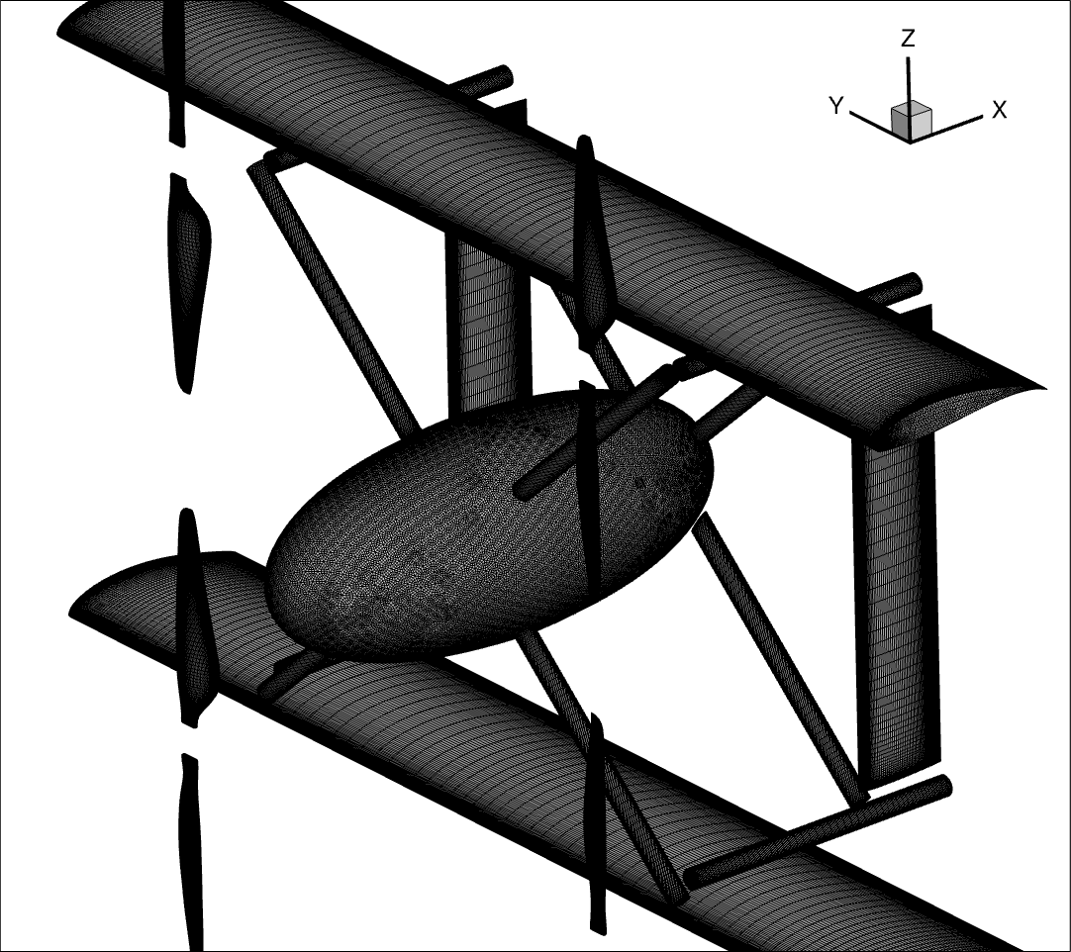
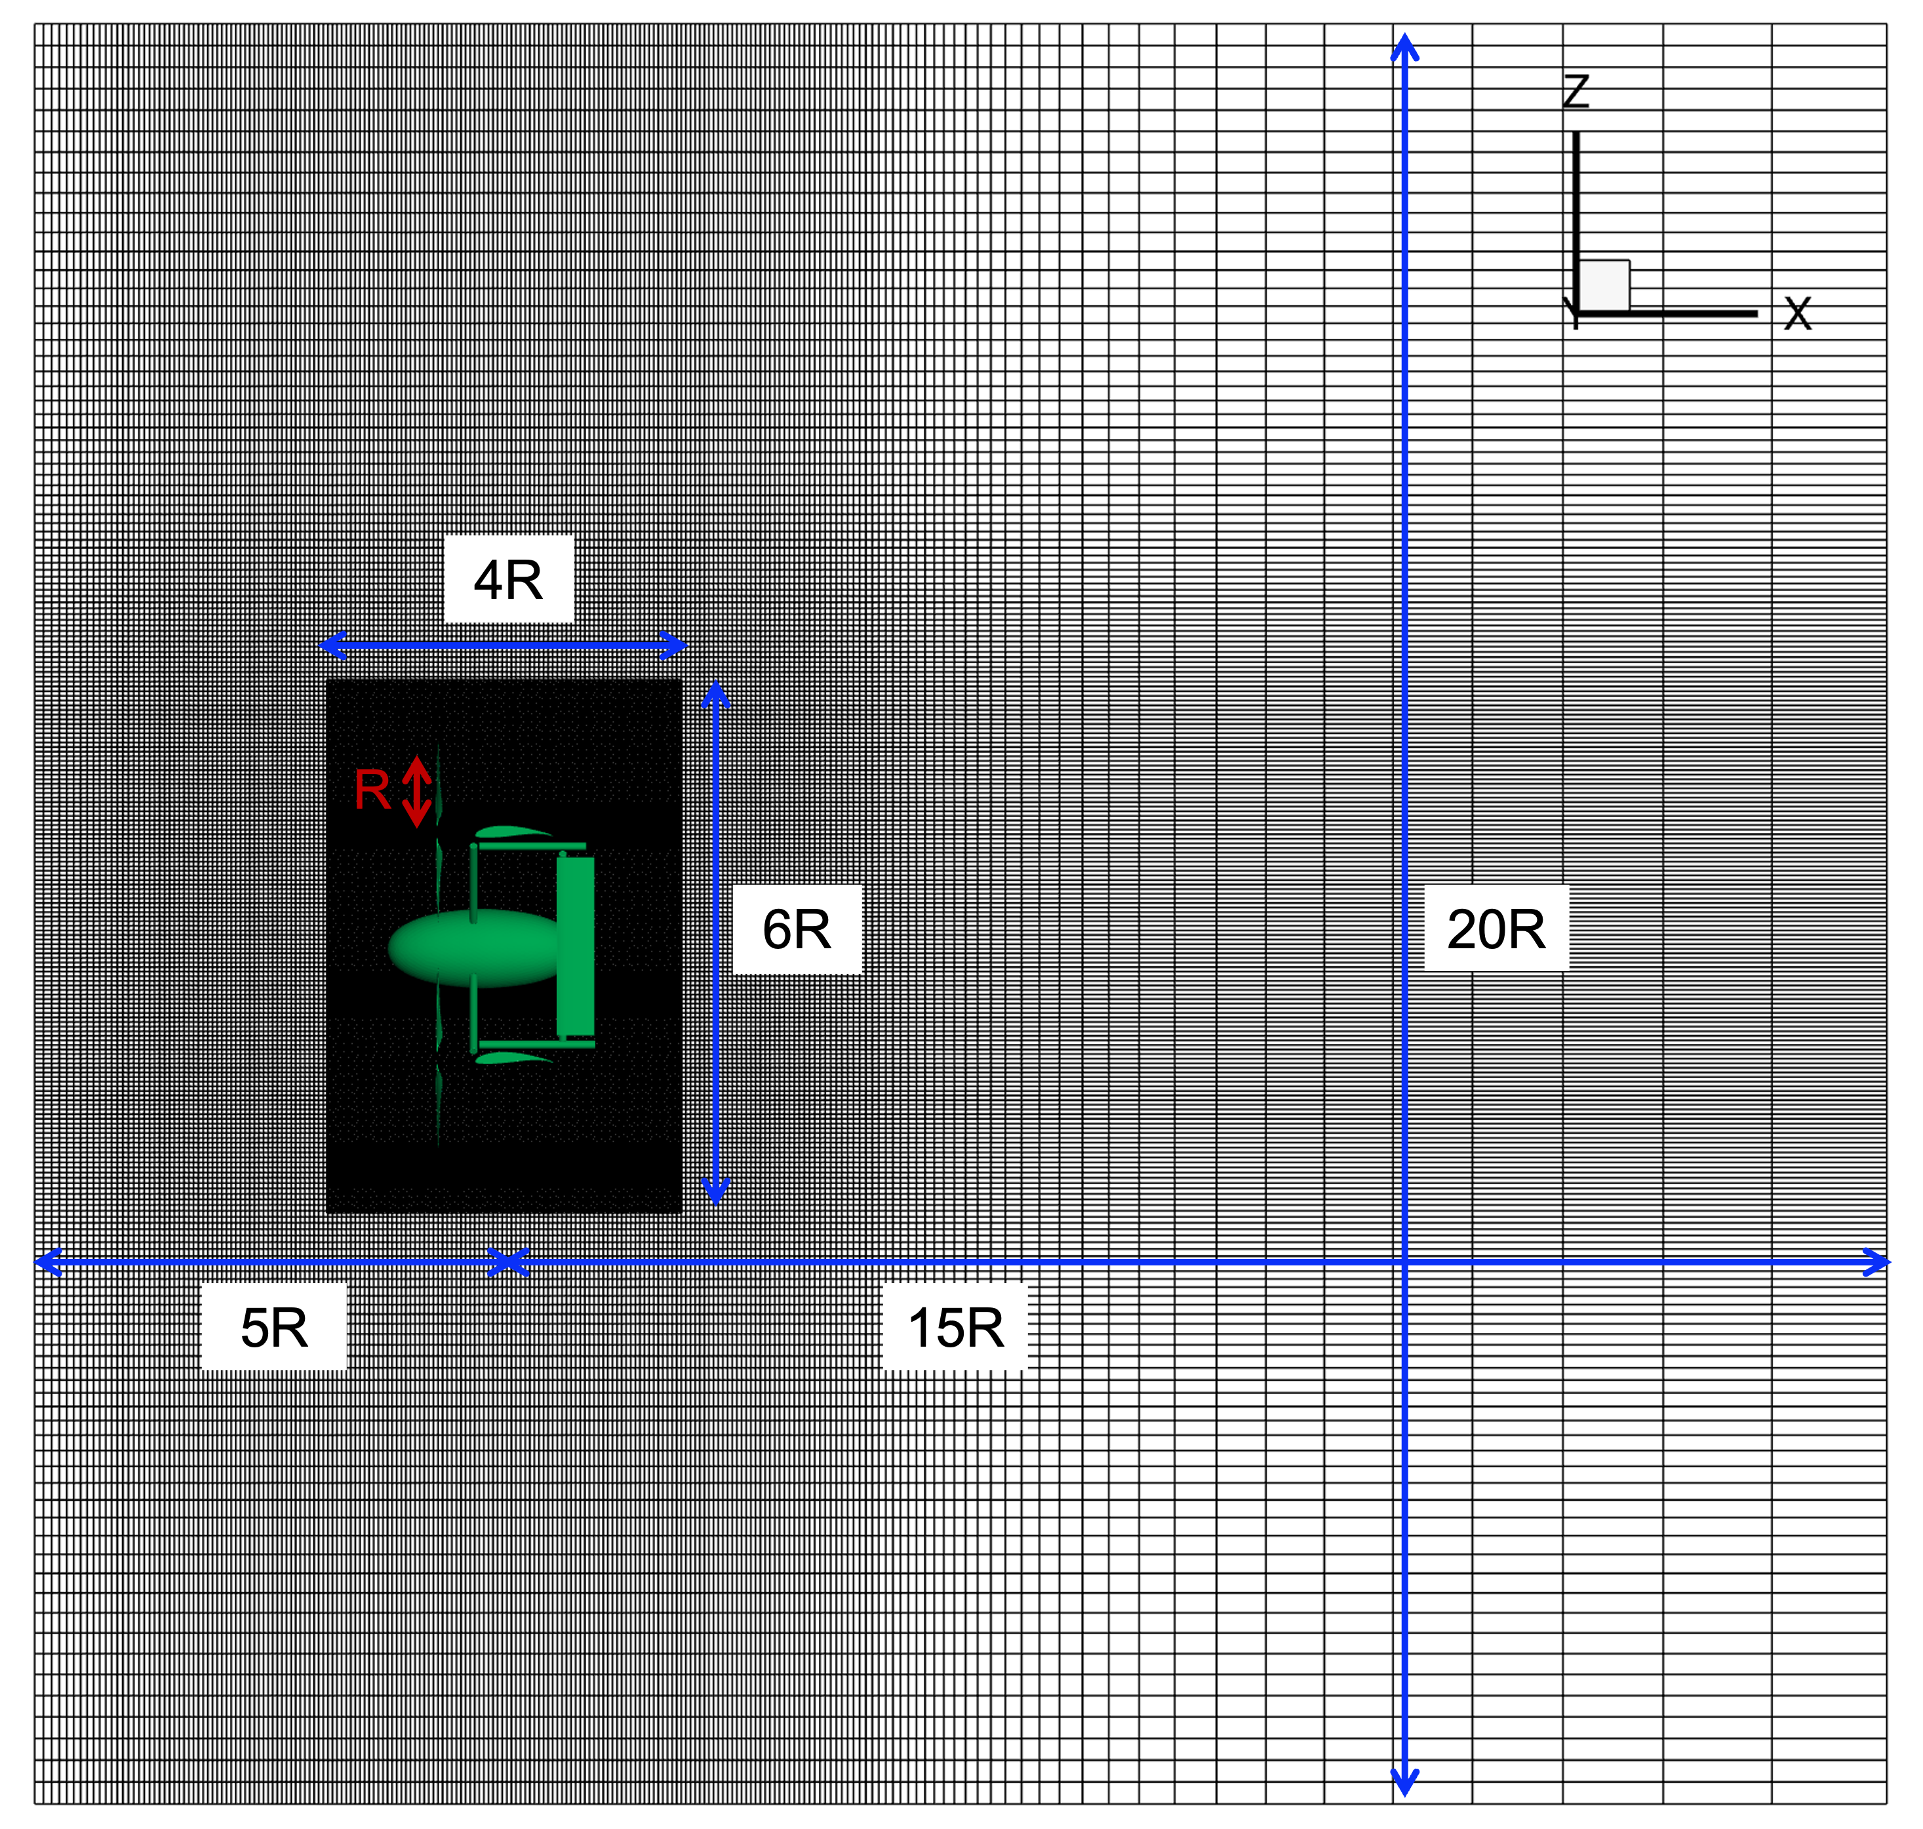
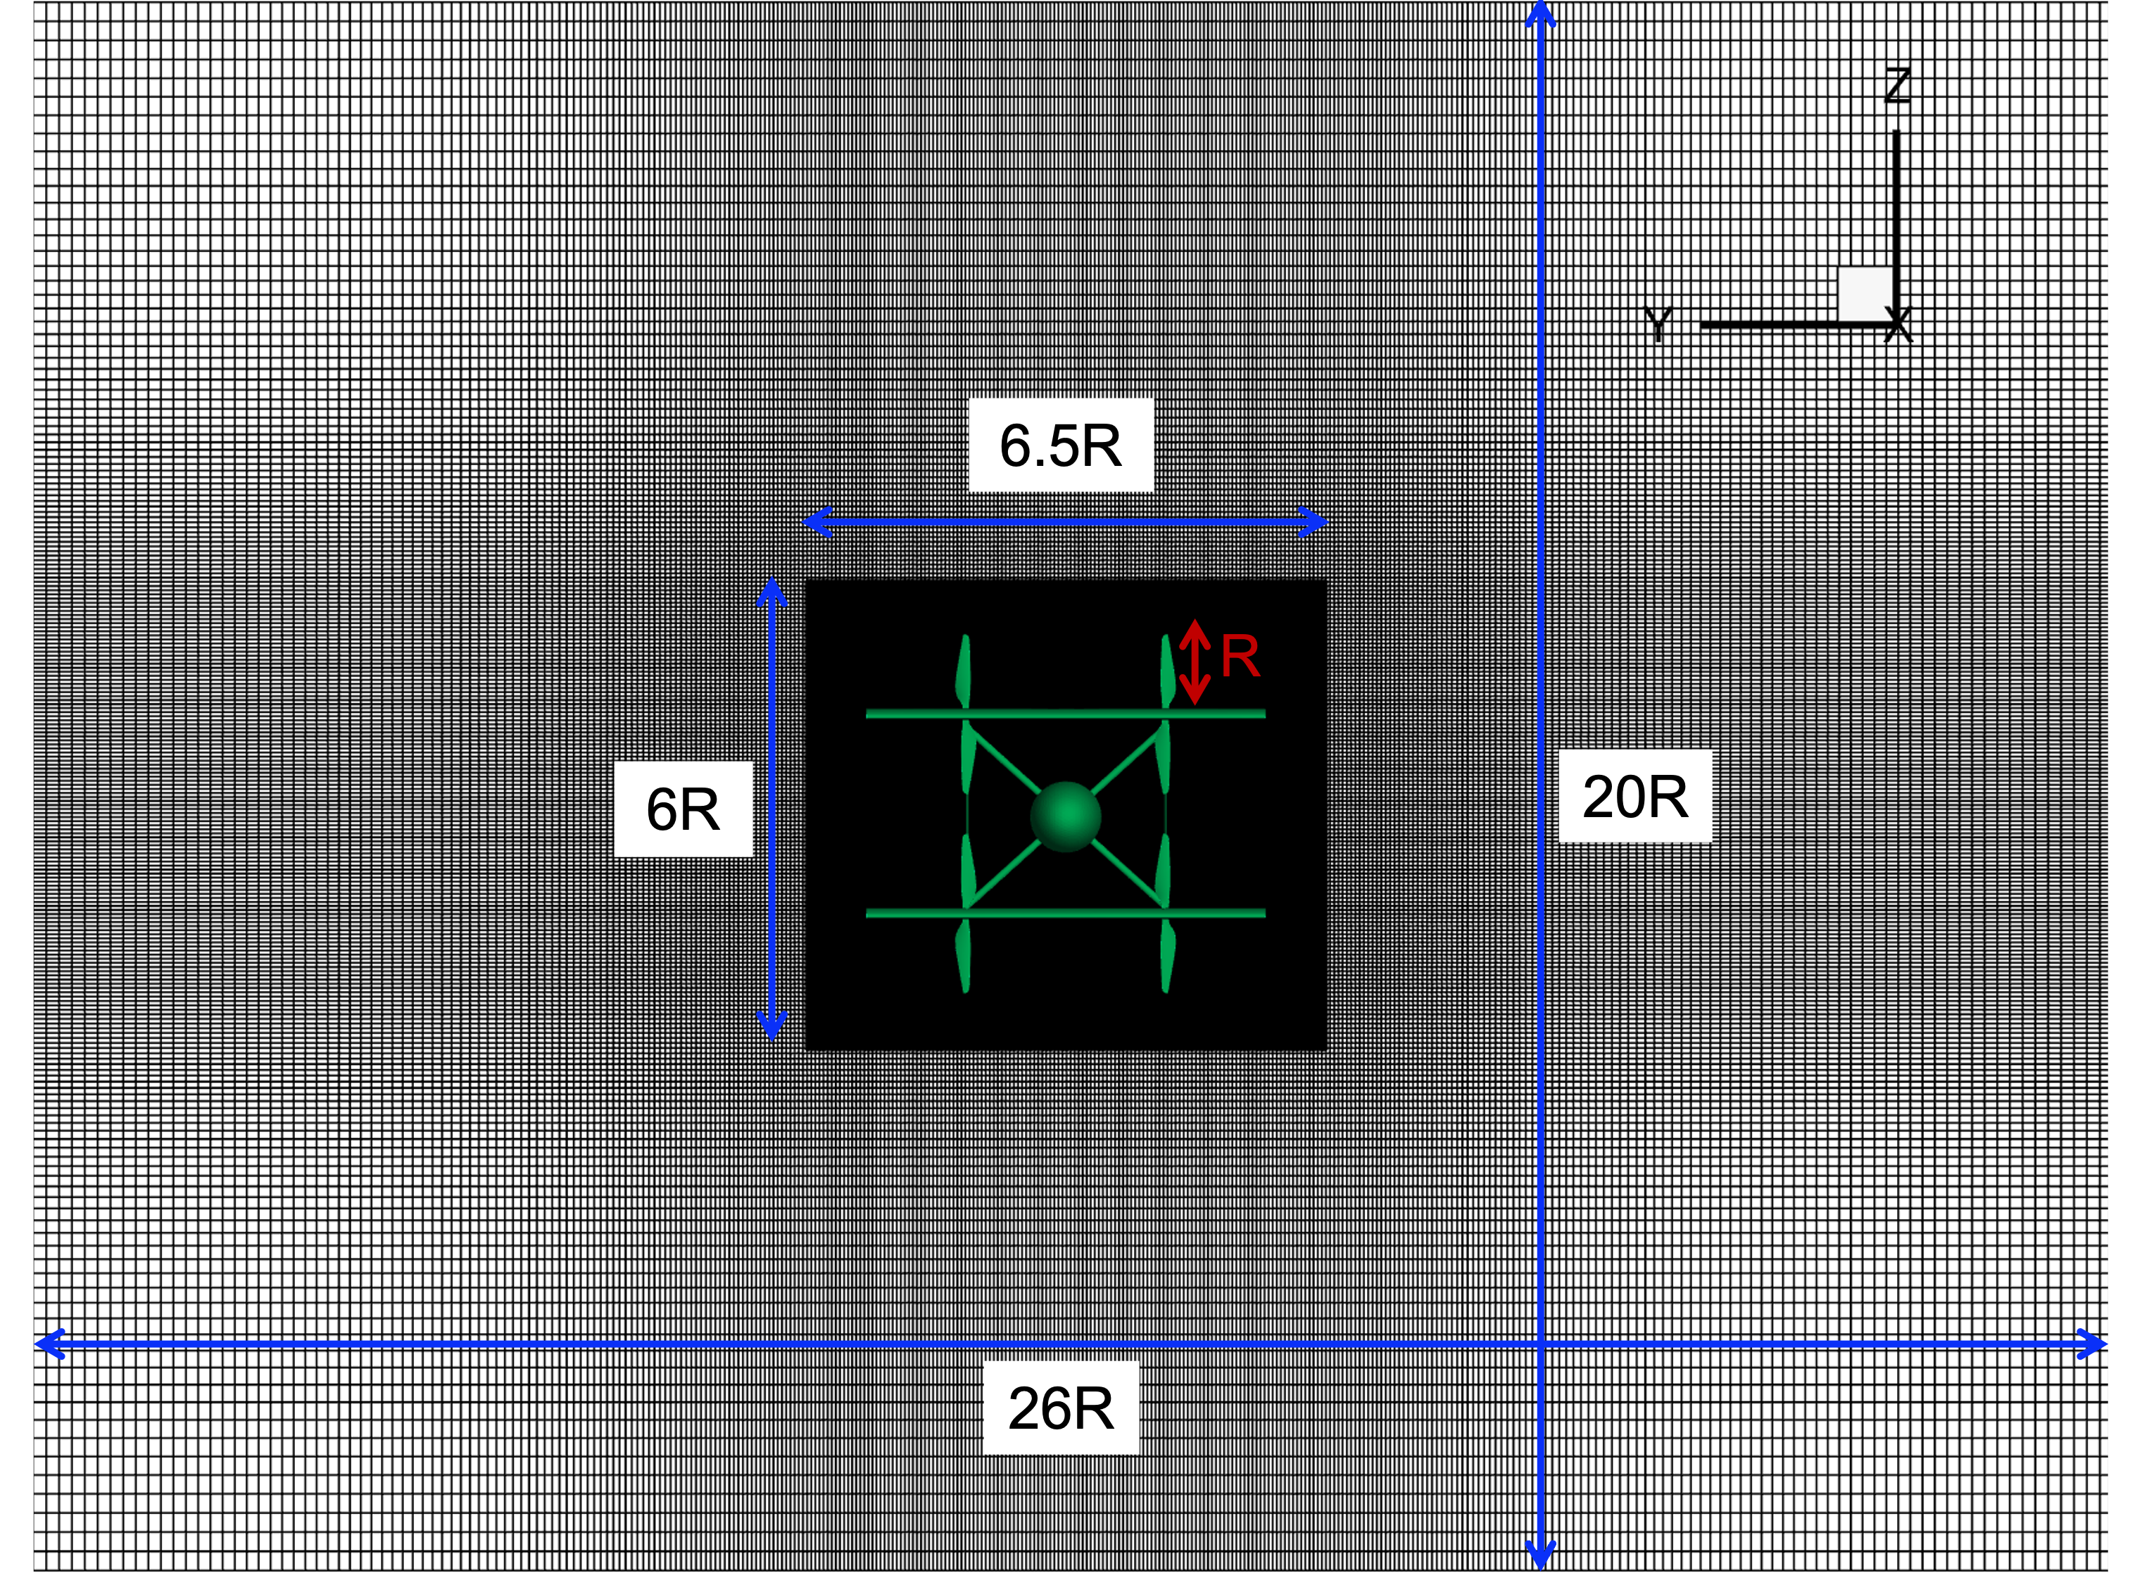
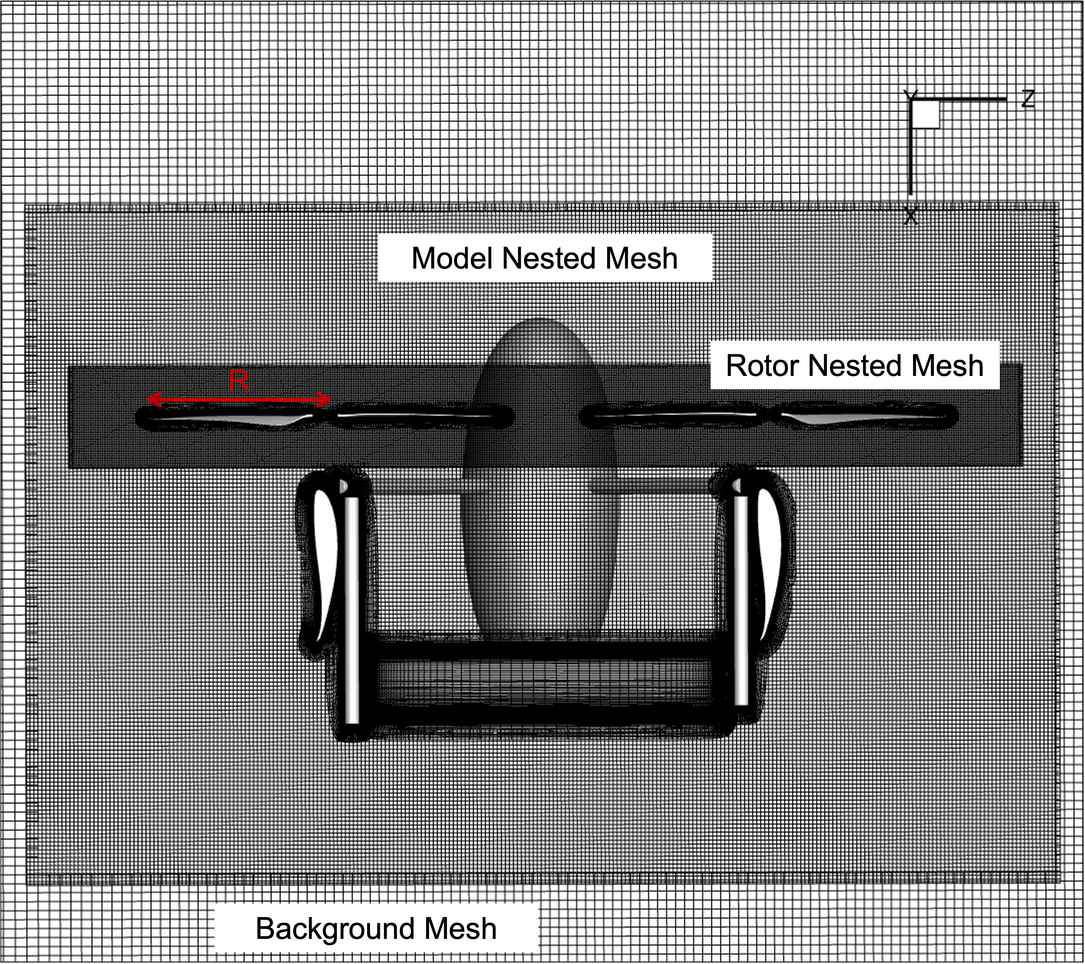
Computational Mesh
University of Maryland
Alfred Gessow Rotorcraft Center
Cross section of flow domain
434,704 elements
Longitudinal section of flow domain
25 Near-body strand meshes
        Initial wall normal spacing of 4.5x10⁻⁶R (y+1)
        Stretching ratio of 1.16
        43 strand layers
4 Off-body Cartesian meshes
        Free slip boundary condition
Surface meshes
Overset mesh system
Notes:
R means what?
What is an element?
Y+1 means y coordinate in the j first layer of the mesh
Talk about how we have three background meshes to properly get wake interactions

Slide 8
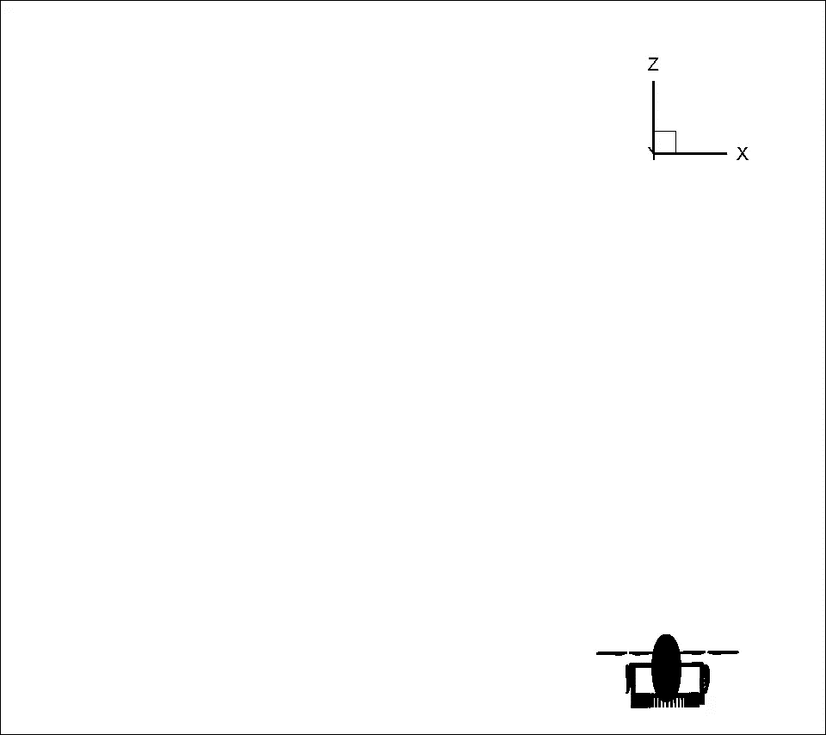
Paulo Maneuver
University of Maryland
Alfred Gessow Rotorcraft Center
Developed prescribed maneuver capabilities:
  Full-body translation
  Multiple frames of rotation
  Rotations about arbitrary axes and origins
  Non-periodic deformations (for collective)
All defined with simple time-history files
  Spline interpolation between user defined times

Slide 9
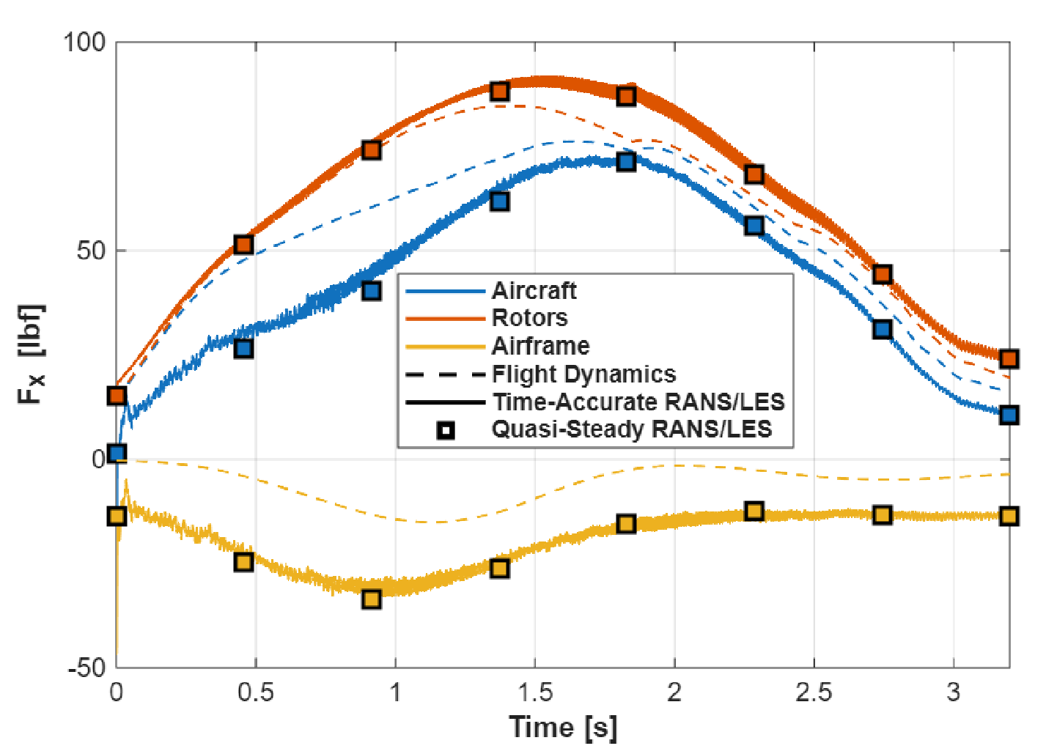
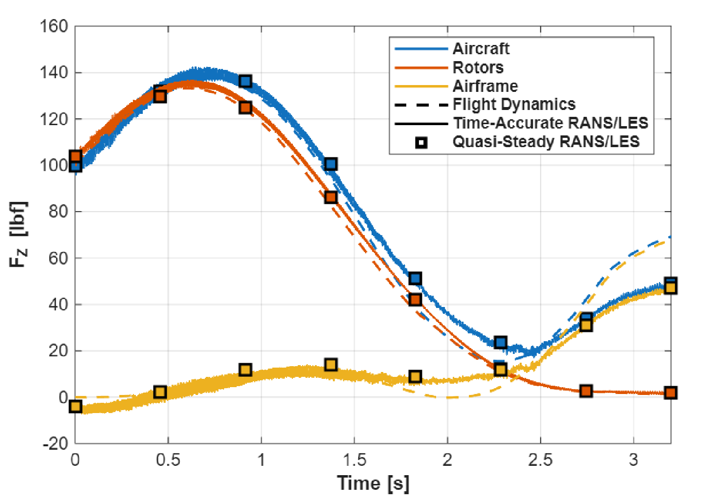
Paulo Maneuver Forces and Quasi-Steady Comparison
University of Maryland
Alfred Gessow Rotorcraft Center
Forces match with quasi-steady results
  Implies that trimming iterations might be of use

Slide 10
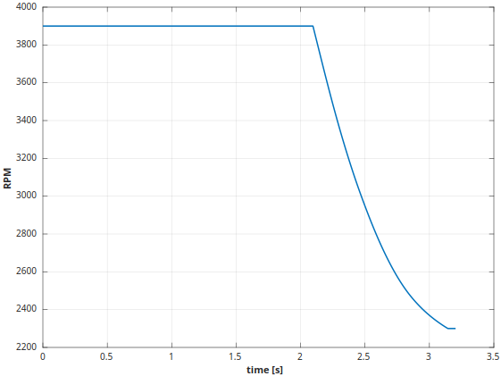
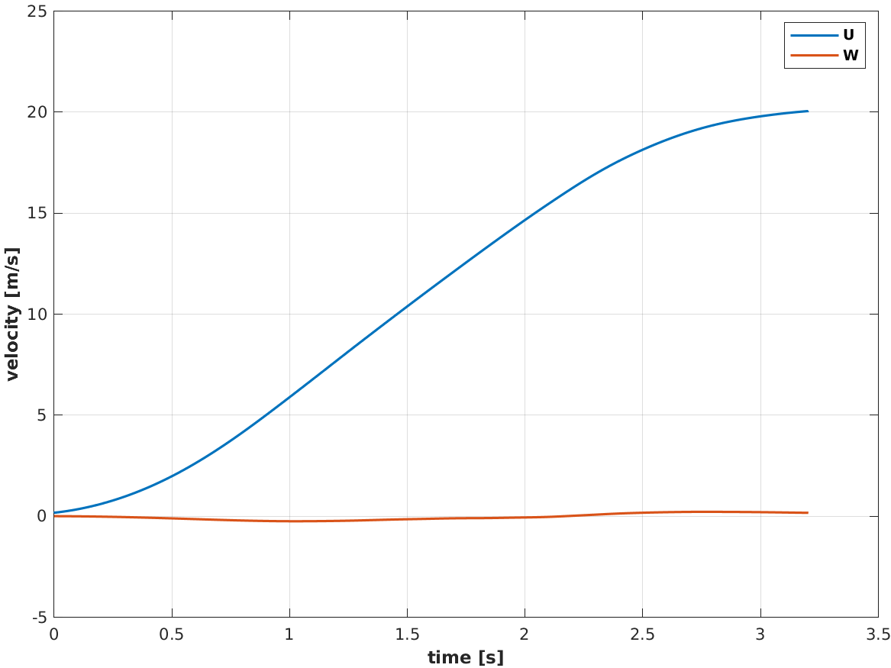
Hover-to-Cruise Transition: Constant Altitude
University of Maryland
Alfred Gessow Rotorcraft Center
RPM
Velocity
Notes:
RPM of the motors
Velocity of the craft
The collectives, and attitude relative to horizon need to be adjusted and will show later

Slide 11
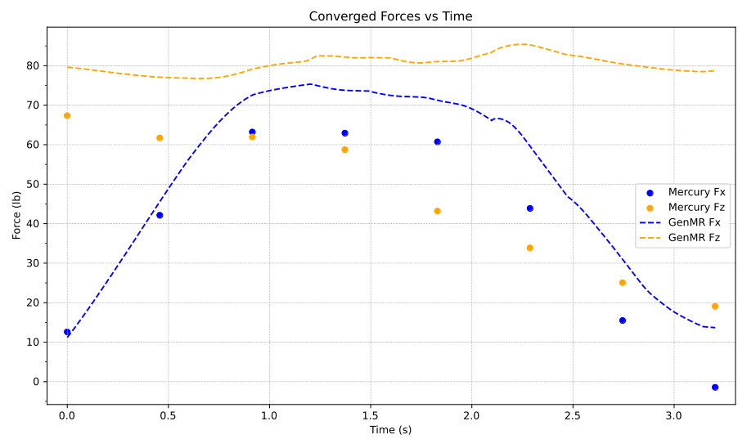
Base Quasi-Steady Simulation
University of Maryland
Alfred Gessow Rotorcraft Center
Direct pitch and collective values from GenMR
Inadequate force matching from GenMR
  Requires Trim Jacobian

Slide 12
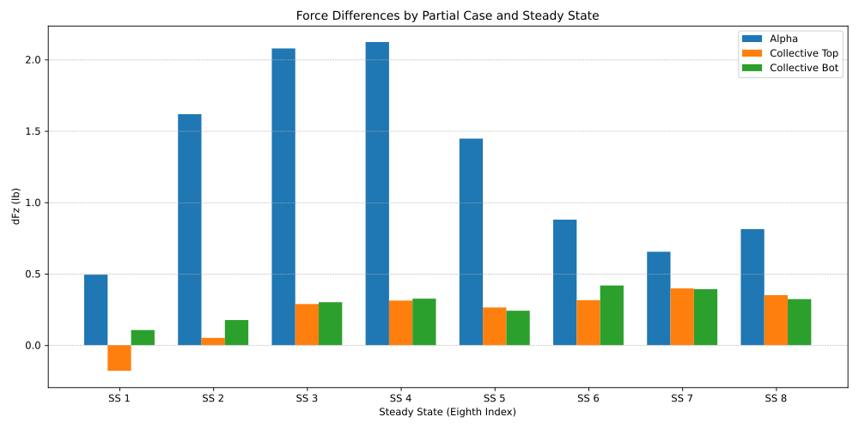
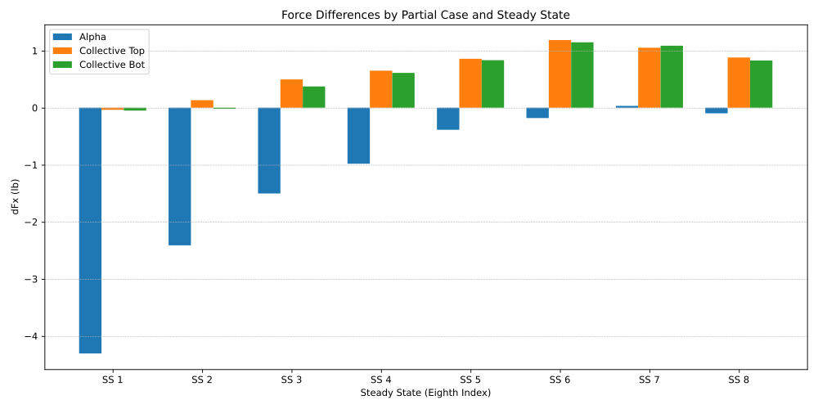
Finding Trim Jacobian
University of Maryland
Alfred Gessow Rotorcraft Center
Using (2-point forward)
  +5% of pitch and each collective
Moment data not available
24 partial cases in total
Collective changes were forced to be equal

Slide 13
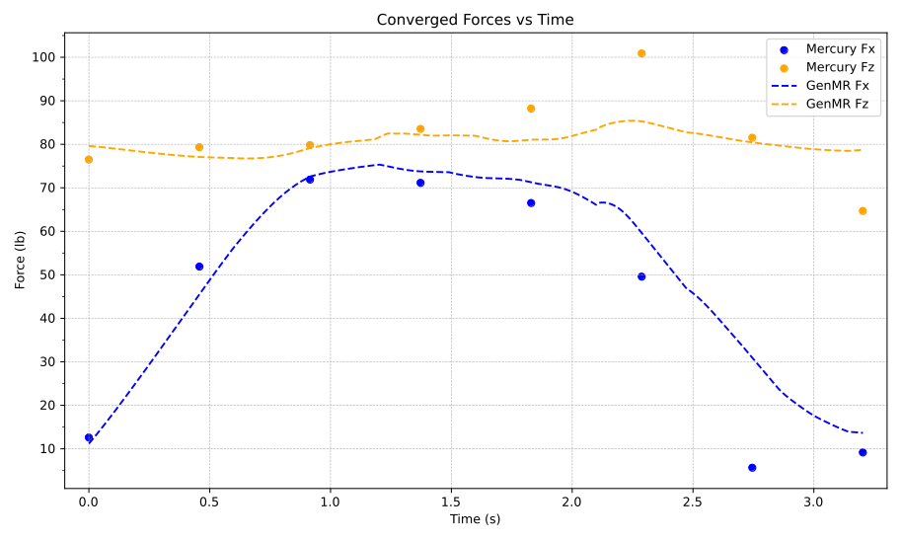
First Trimming Iteration
University of Maryland
Alfred Gessow Rotorcraft Center

Slide 14
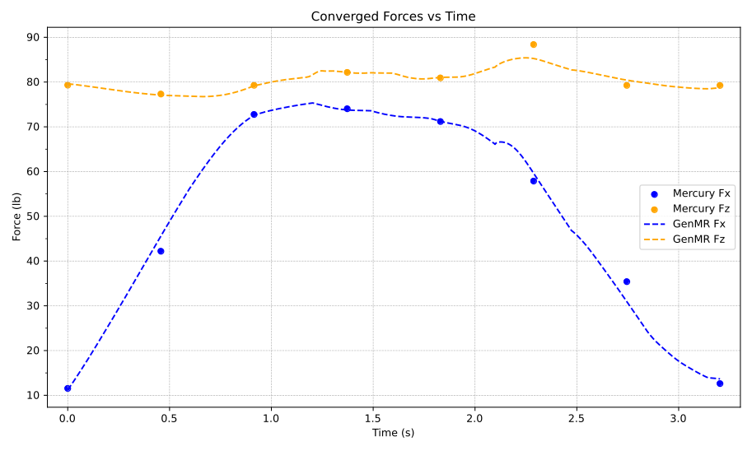
Third Trimming Iteration
University of Maryland
Alfred Gessow Rotorcraft Center

Slide 15
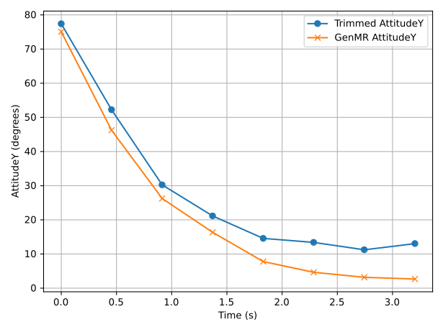
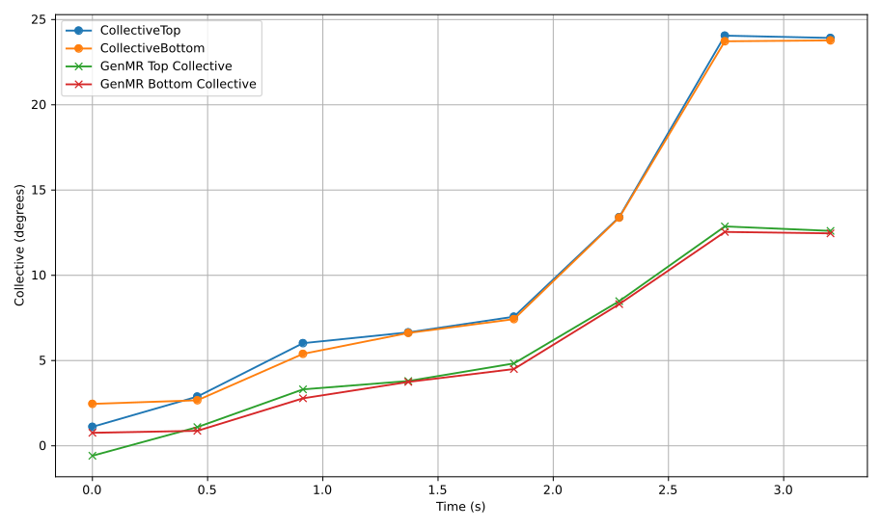
New Control Values
University of Maryland
Alfred Gessow Rotorcraft Center

Slide 16
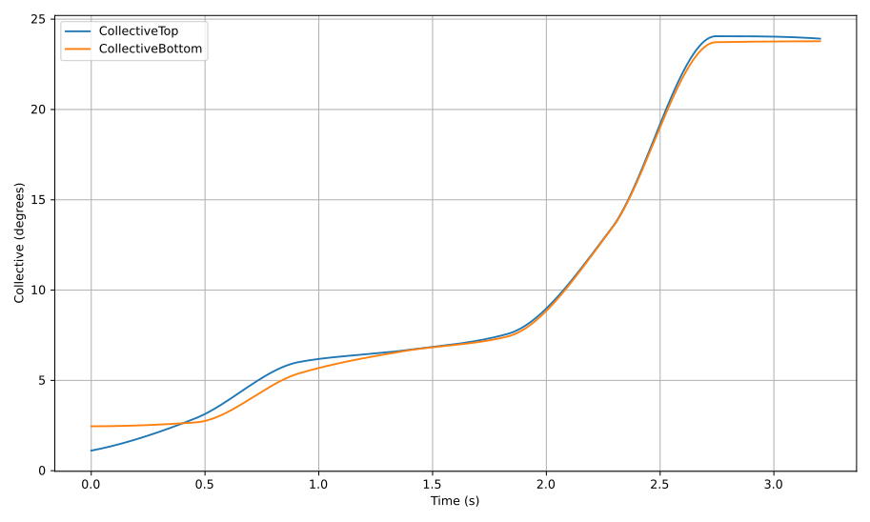
Interpolation
University of Maryland
Alfred Gessow Rotorcraft Center
Notes:
Interpolated using PCHIP

Slide 17
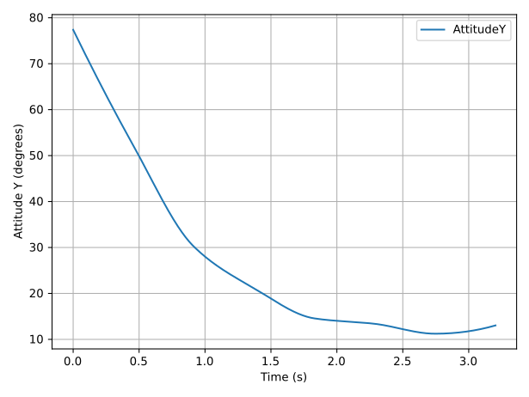
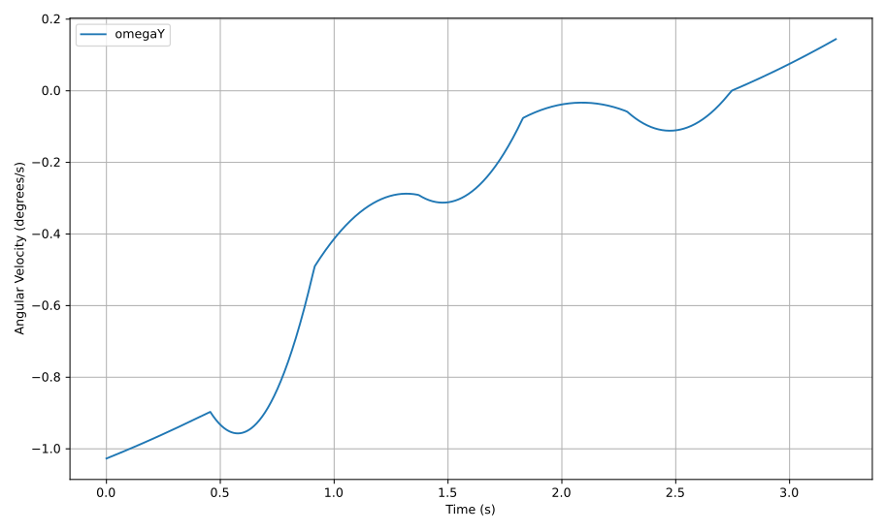
Interpolation
University of Maryland
Alfred Gessow Rotorcraft Center
Attitude data must be converted to a rotational speed
Notes:
Int using PCHIP to get Attitude Y then differentiated to get omega Y

Slide 18
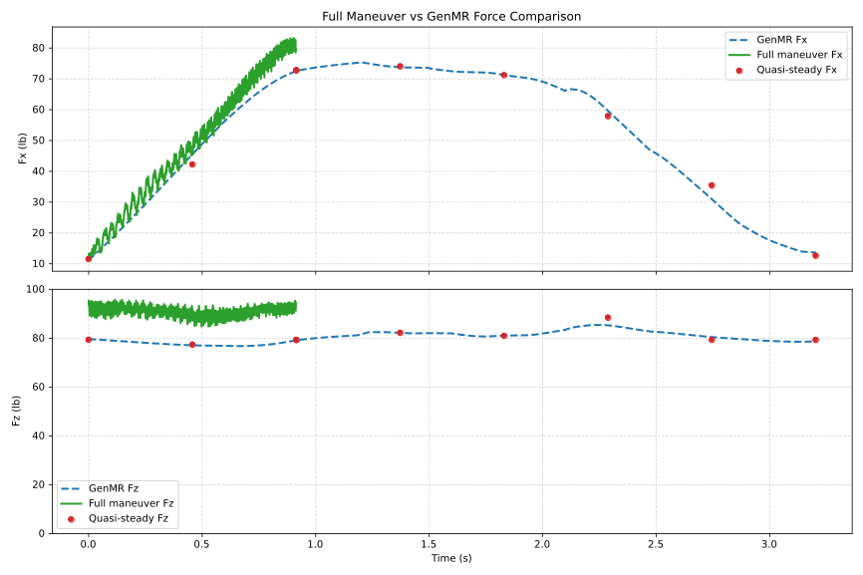
Full Unsteady Simulation
University of Maryland
Alfred Gessow Rotorcraft Center

Slide 19
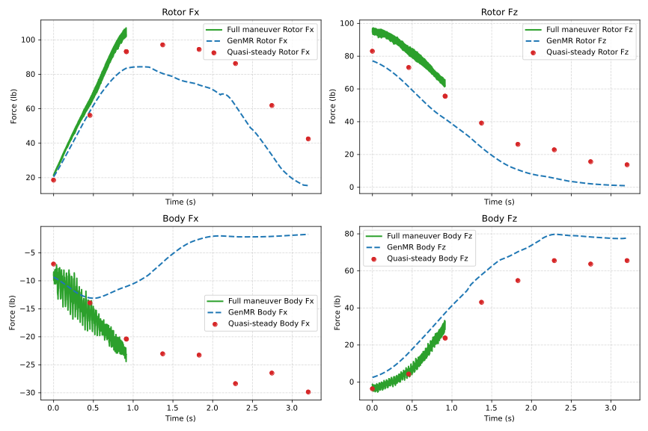
Full Unsteady Simulation
University of Maryland
Alfred Gessow Rotorcraft Center

Slide 20
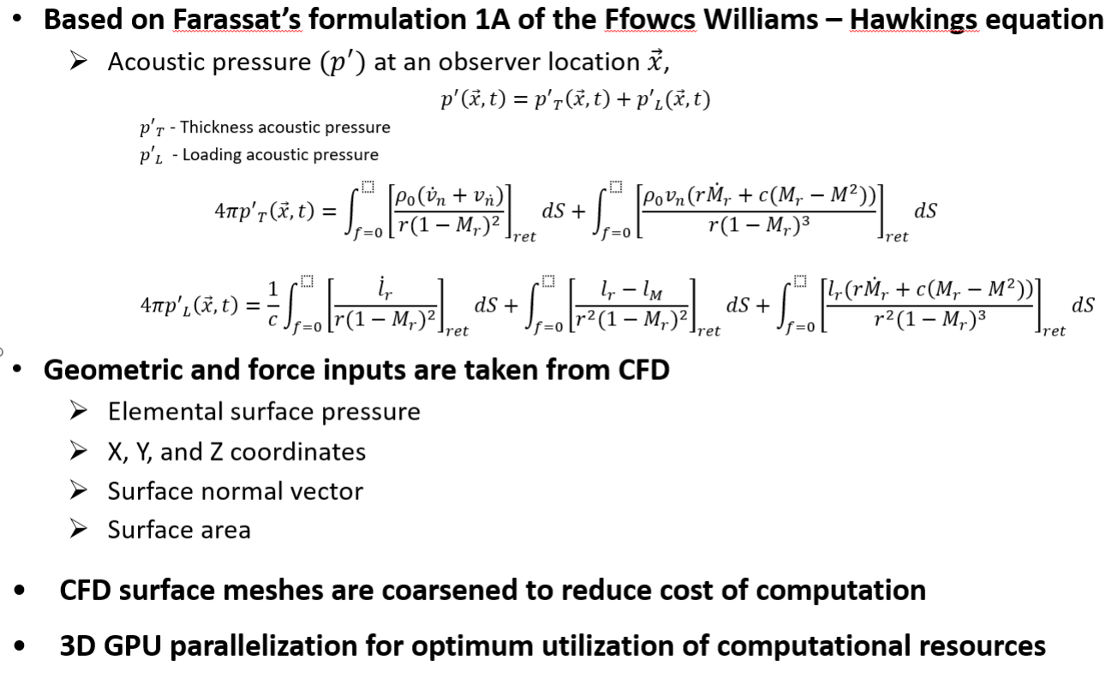
University of Maryland
Alfred Gessow Rotorcraft Center
ACM – Acoustic Code University of Maryland

Slide 21
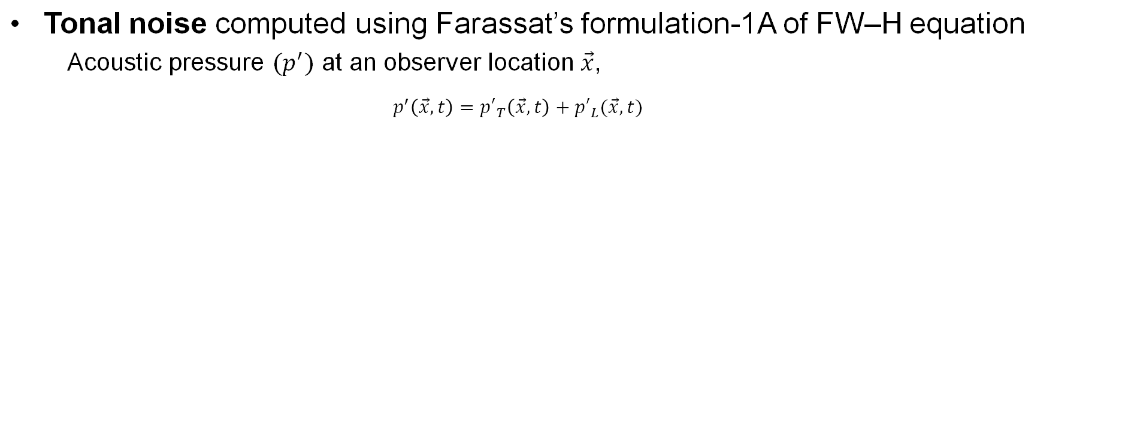
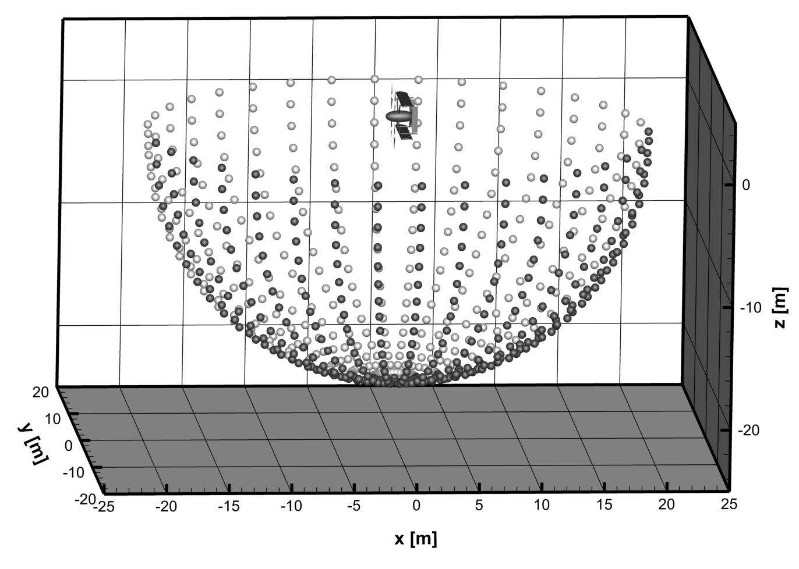
Acoustic Solver – ACM
University of Maryland
Alfred Gessow Rotorcraft Center
Broadband noise
Brooks, Pope, and Marcolini (BPM) model
Observers at a 20 m distance
  Roughly 30 rotor diameters
  Hemispheric set below the aircraft
Notes:
Reference ACUM and or implementation of BPM into ACUM

Slide 22
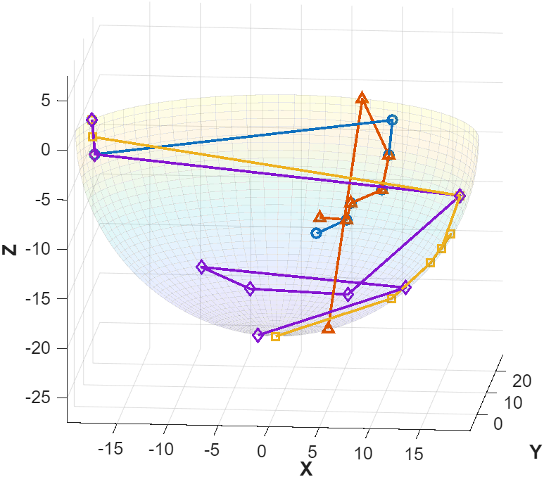
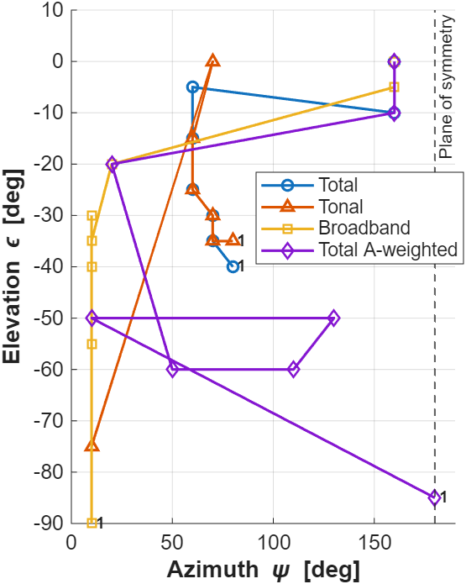
Maximum Noise Location Paulo Maneuver
University of Maryland
Alfred Gessow Rotorcraft Center

Slide 23
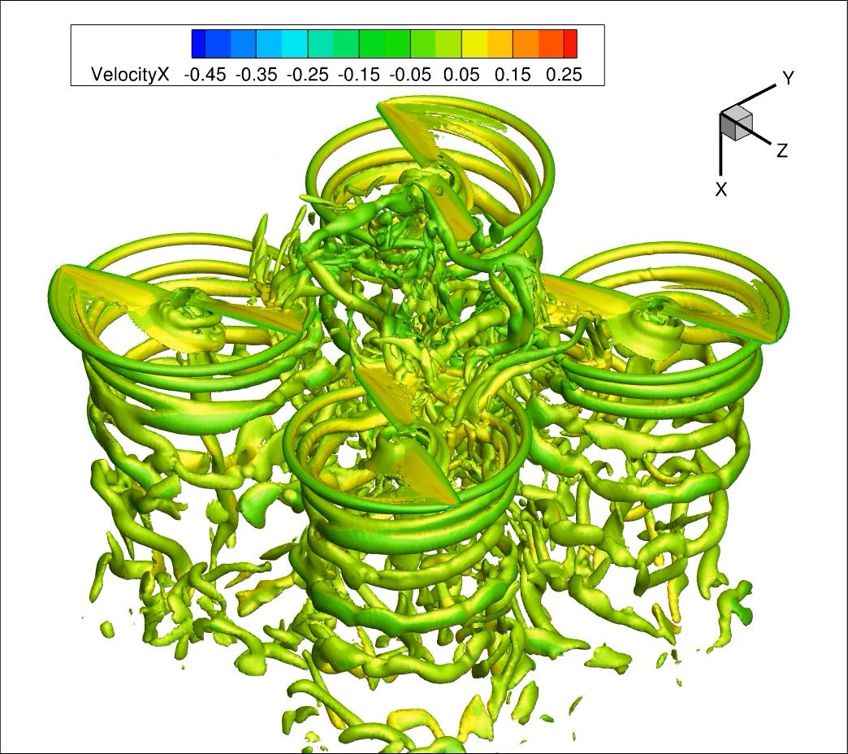
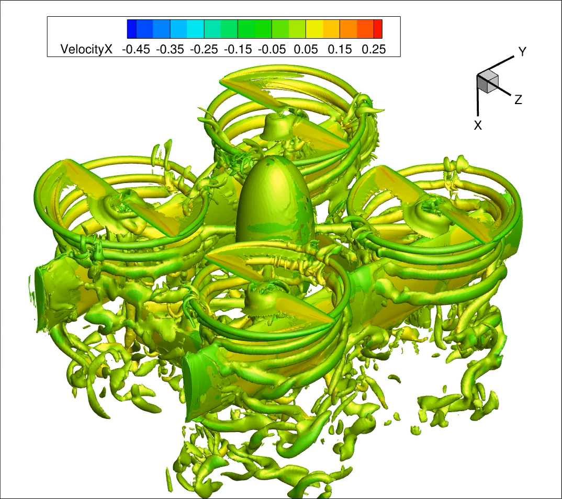
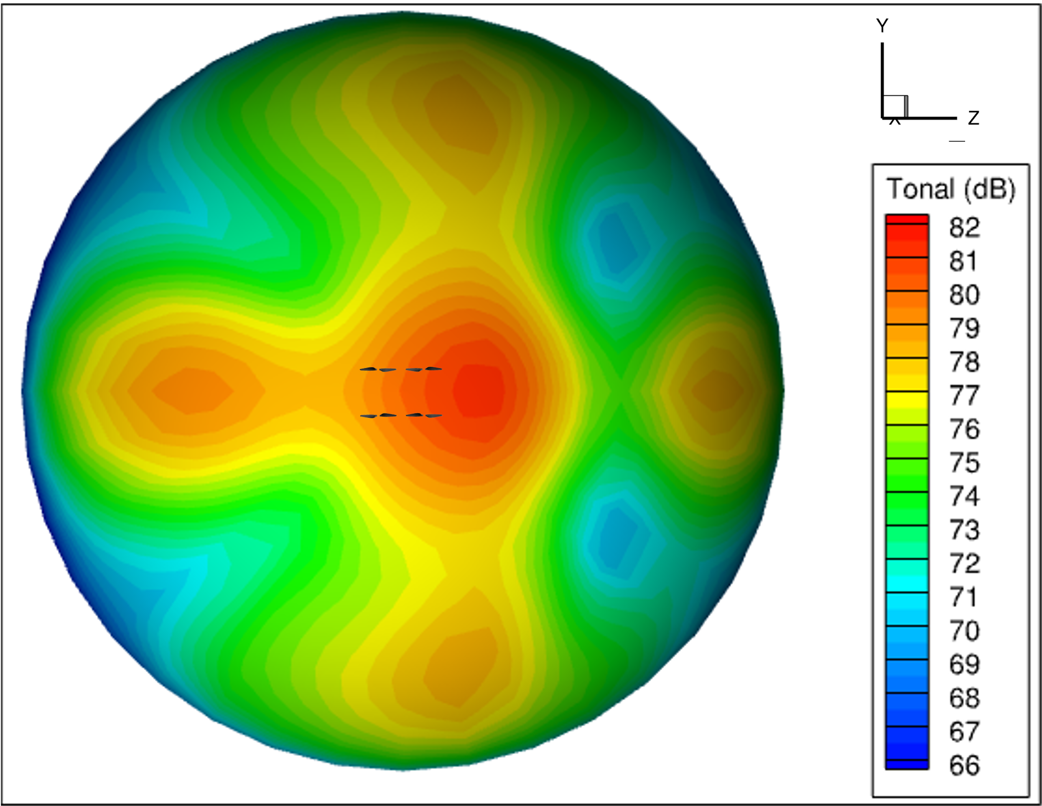
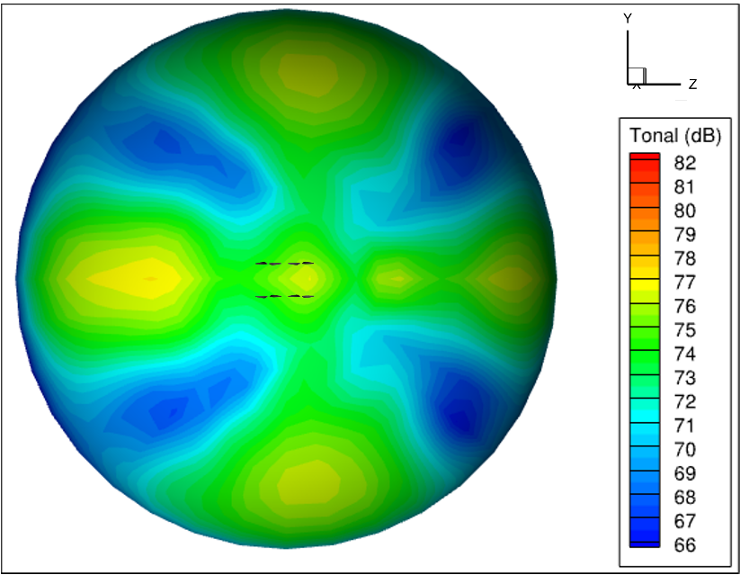
Tonal Noise of Uninstalled and Installed Rotor Systems – Hover
University of Maryland
Alfred Gessow Rotorcraft Center
Uninstalled Rotor System
Installed Rotor System
Higher Noise
Lower Noise
Installed rotor system has a lower tonal noise footprint due to less rotor-rotor interactions
Notes:
Here we see the effects of lower interactions on acoustics (for installed rotor system)

Slide 24
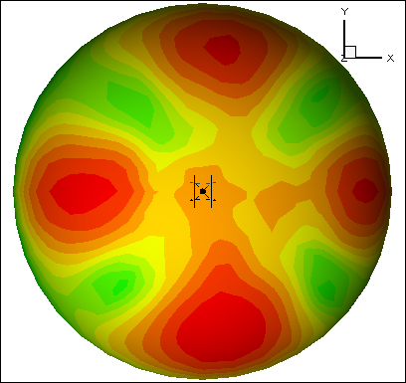
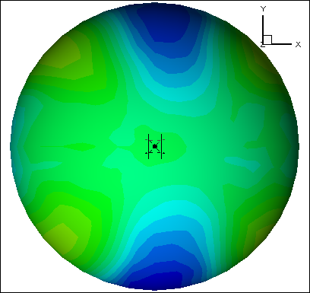
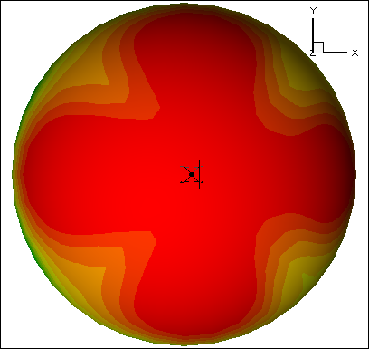
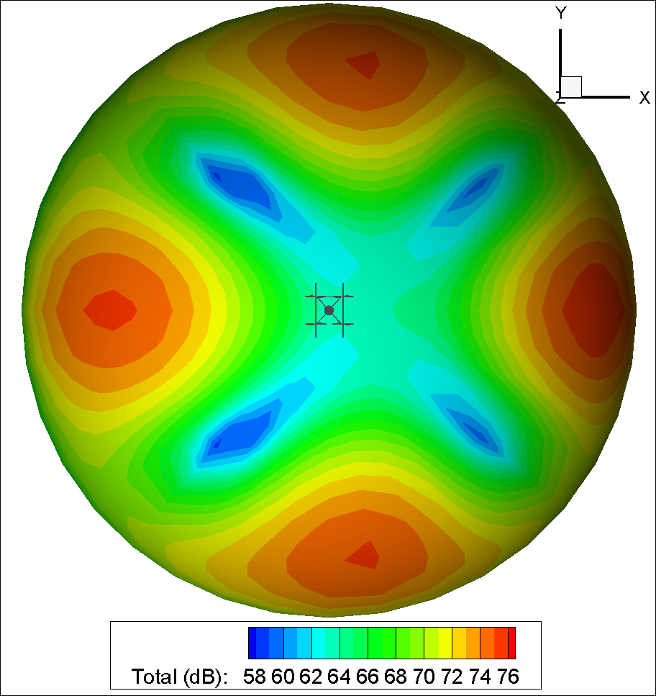
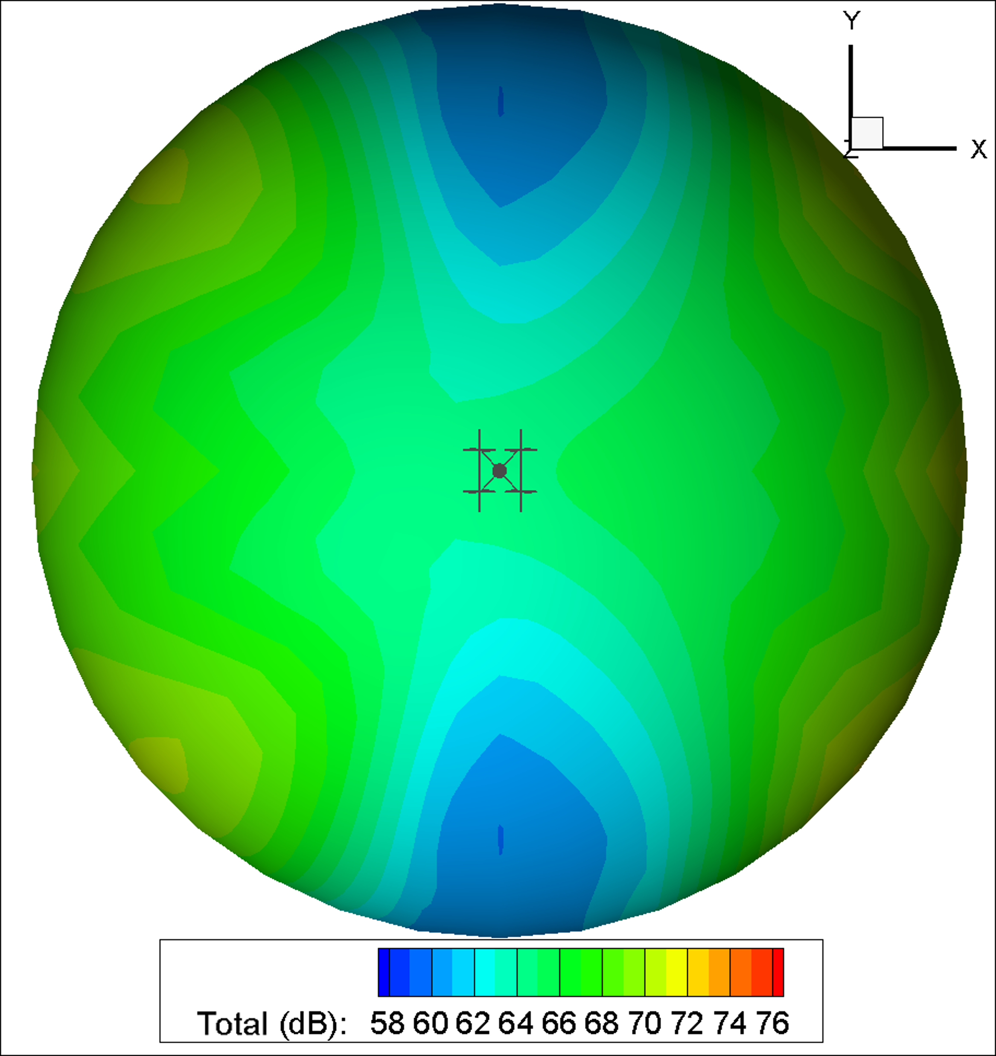
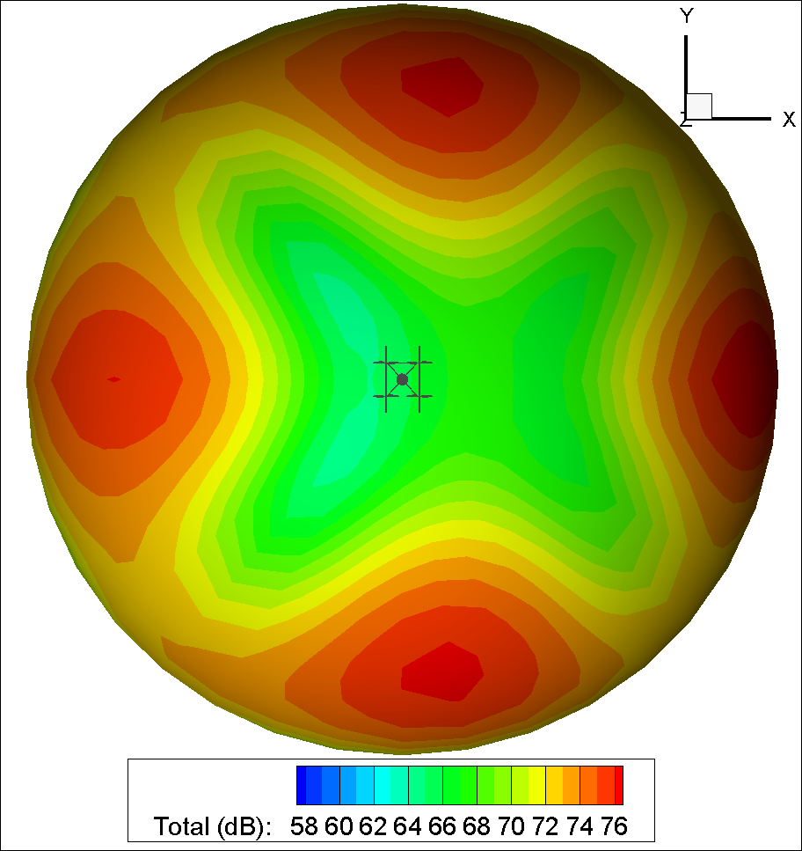
Hover vs Climb (3 m/s) Acoustic Comparison
University of Maryland
Alfred Gessow Rotorcraft Center
Rotor
Airframe
Total
Hover
Climb

Slide 25
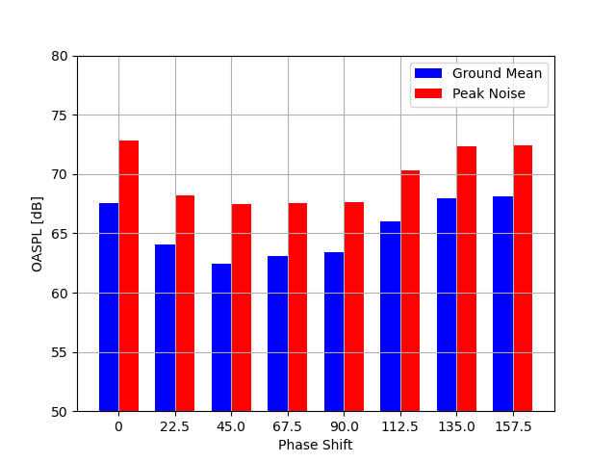
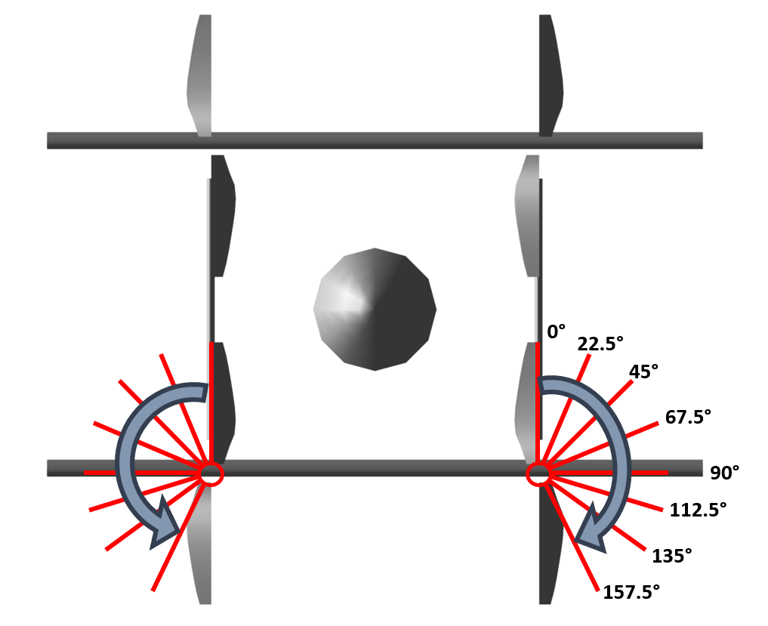
Rotor Phasing Optimization
University of Maryland
Alfred Gessow Rotorcraft Center
Eight different configurations considered in optimization

Slide 26
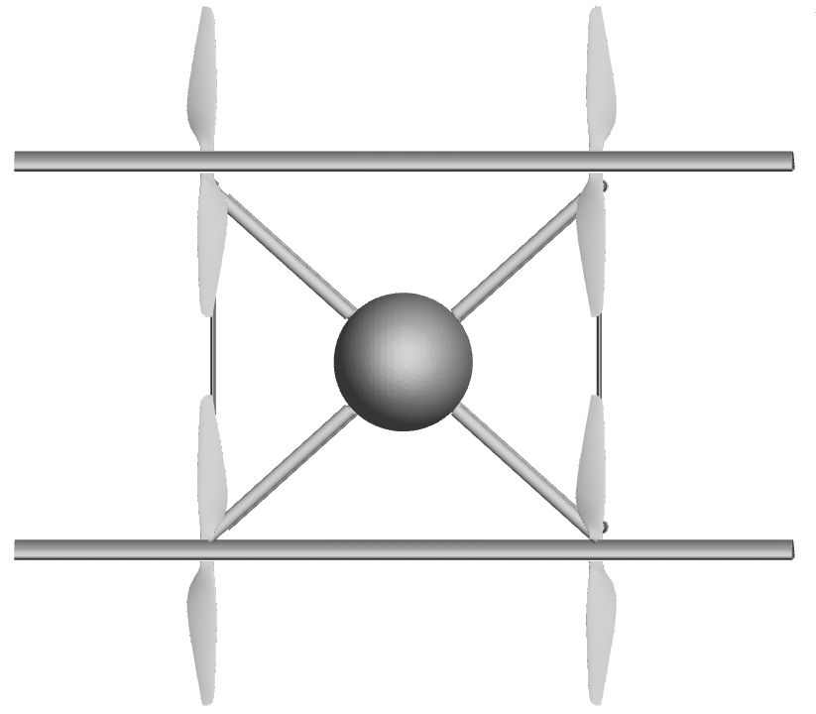
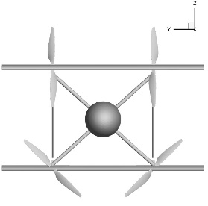
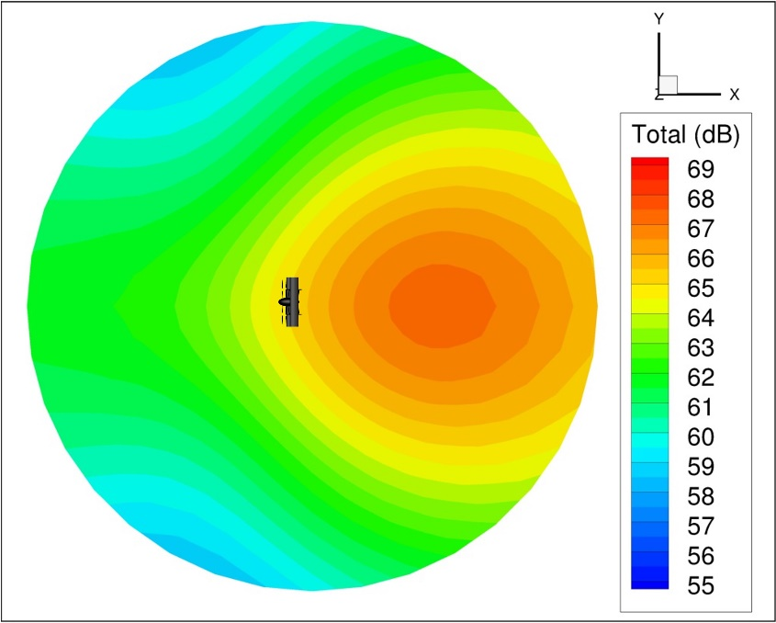
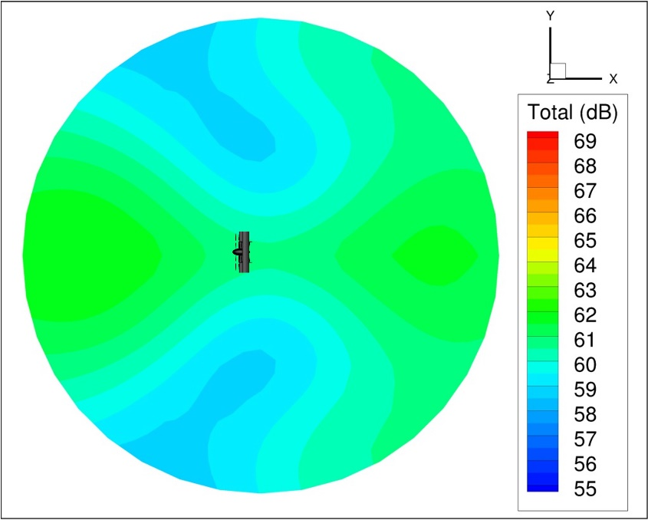
Total Aircraft Noise – Ground Plane (Forward Flight)
University of Maryland
Alfred Gessow Rotorcraft Center
Unphased
Synchrophased
Synchrophasing reduces total aircraft noise by about 5-6 dB
Notes:
Different observer set, ground plane, 5-6 dB reduction

Slide 27
University of Maryland
Alfred Gessow Rotorcraft Center
Questions?

